Slide 1
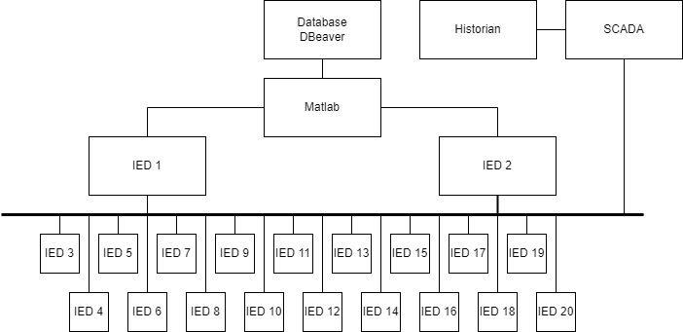
Overview

Slide 2
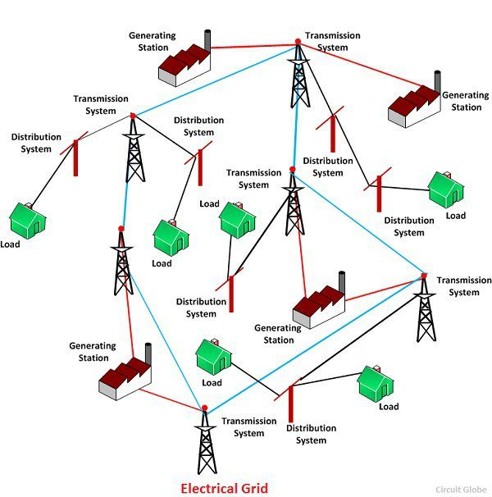
Intelligent Electronic Device- IED
Protection device – Circuit breaker / relays
Transmission line
Record and monitor operational data
Supervisory Control and Data Acquisition-SCADA
Monitor and Control large electrical networks
Provide operator real-time data from all Substations
Manage and maintain network during a fault
Wide area connection [1]

Slide 3
Project Objectives
To create functionalities of an IED, SCADA and circuit breaker in raspberry pi.
To assemble multiple Raspberry PI single-board computers.
To monitor and control the digital twin power distribution through raspberry pi.
Write a program using node-red to calculate the data from the MATLAB digital twin and execute the circuit breaker control

Slide 4
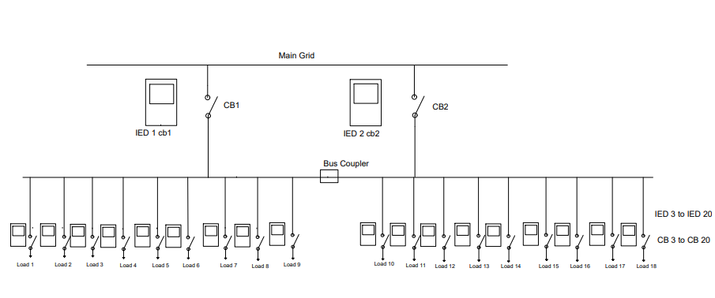
Electrical layout

Slide 5
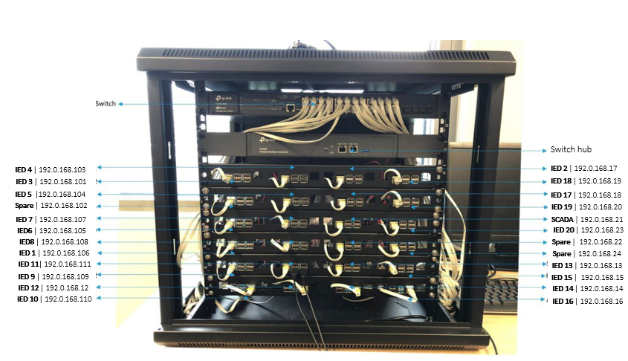
Raspberry Pi

Slide 6
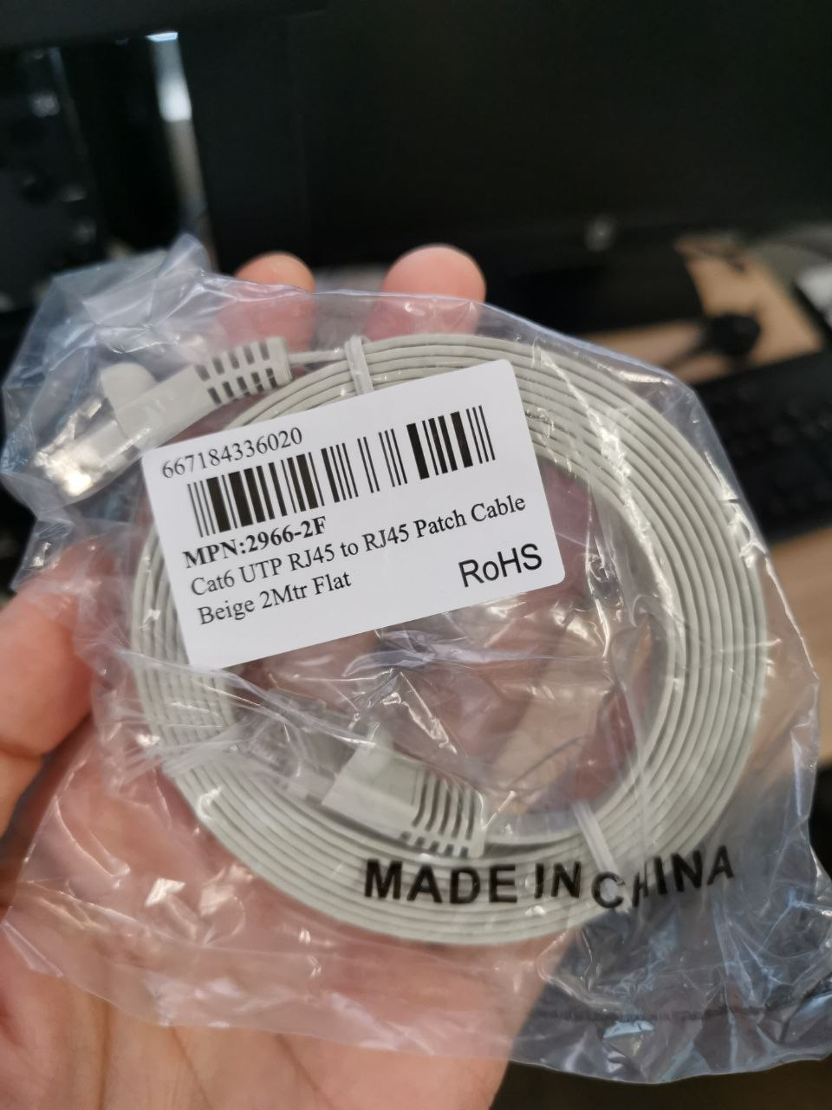
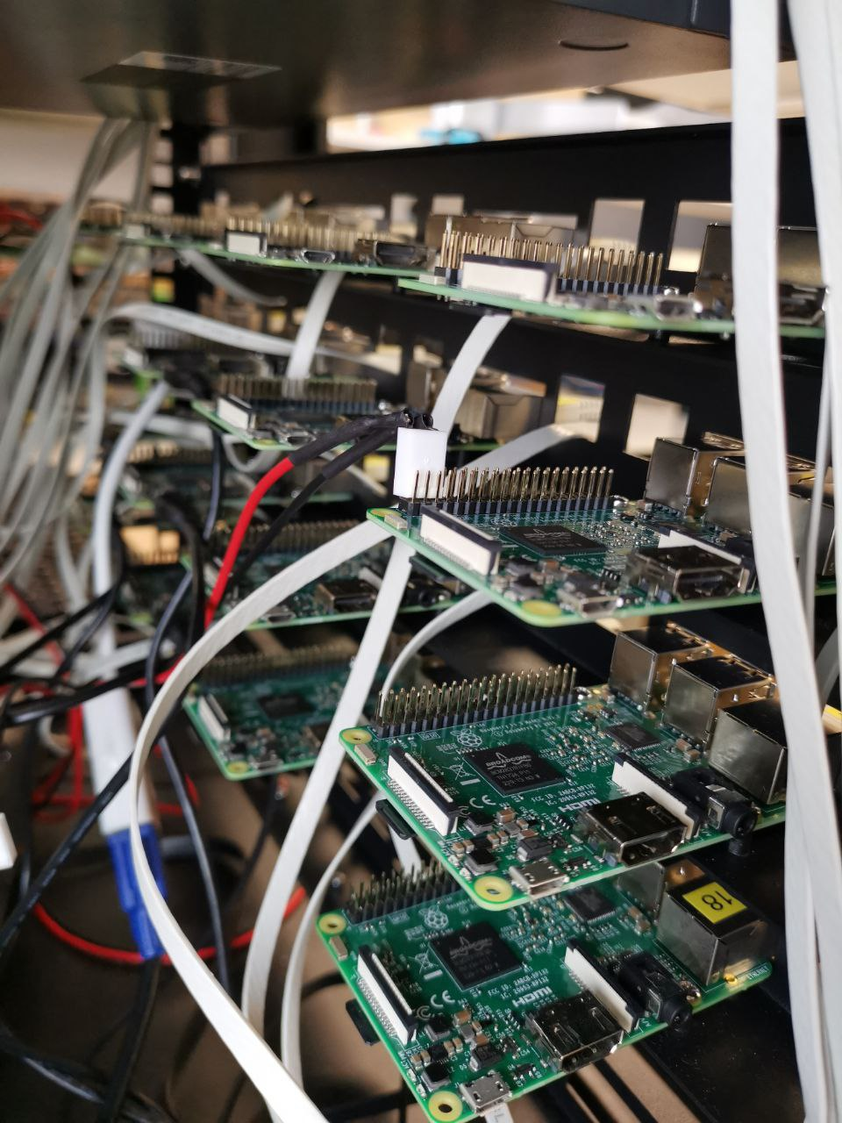
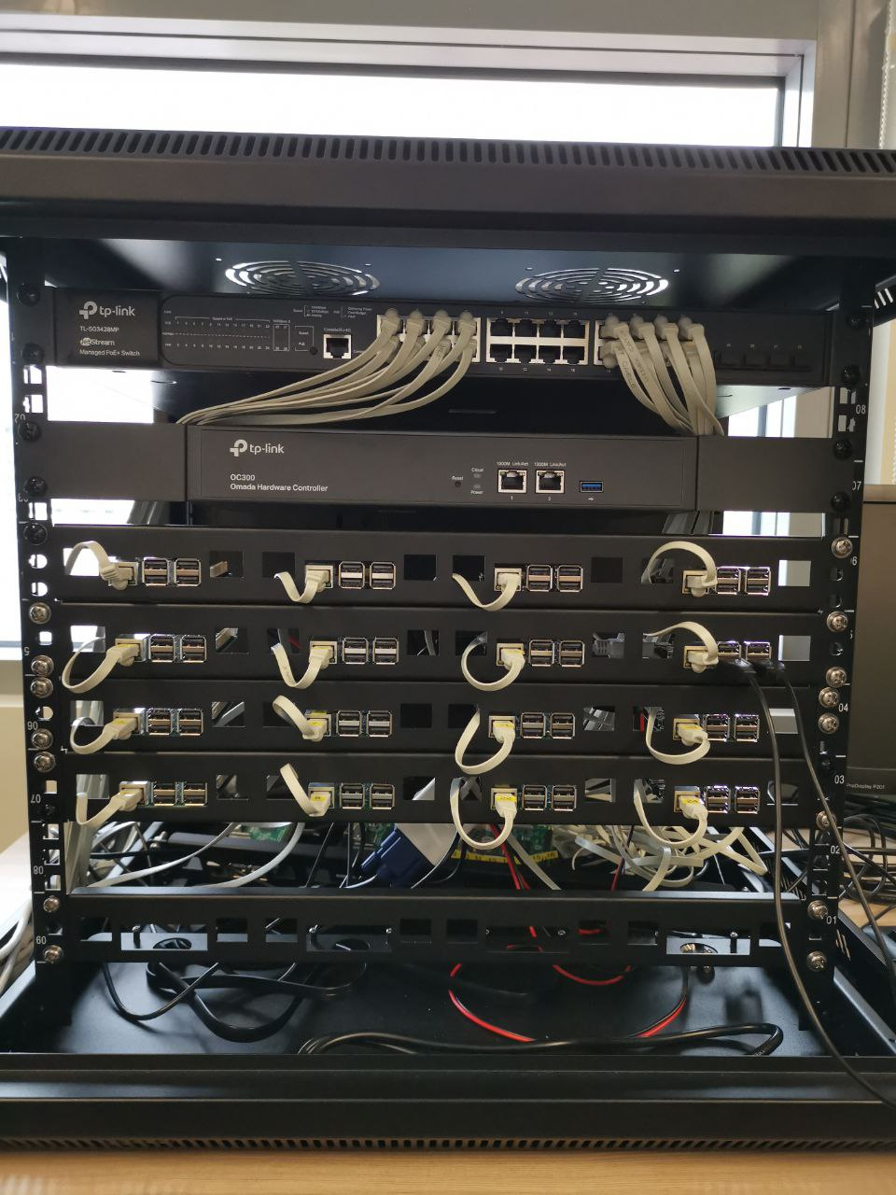
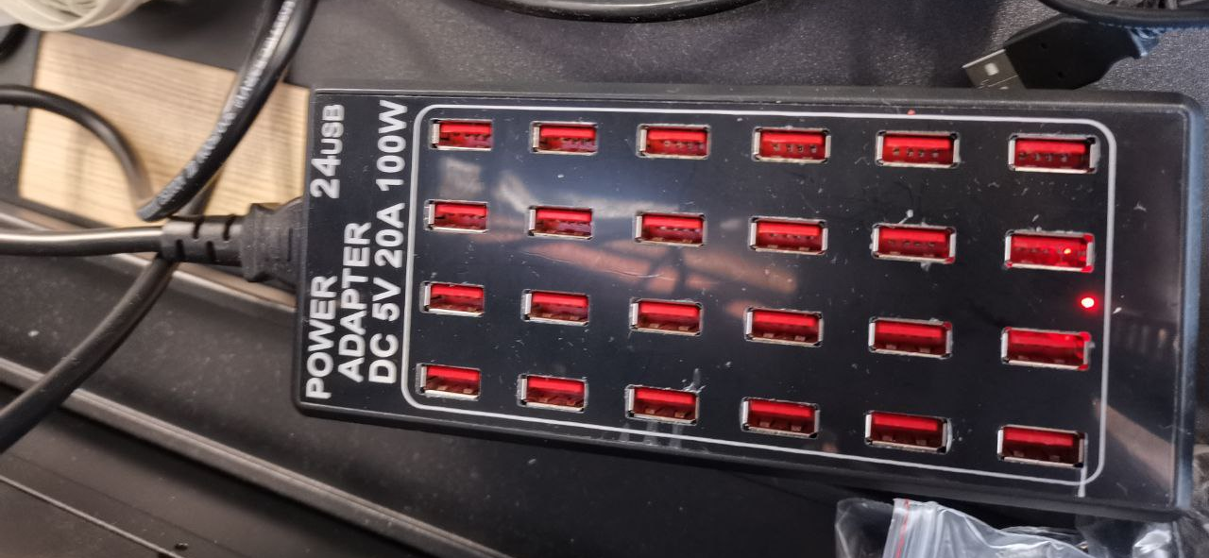
Configurations
1.UTP cable
3. Mounting the raspberry pi boards
4. Multiple raspberry pi boards connections to the switch
2. 5V supply

Slide 7
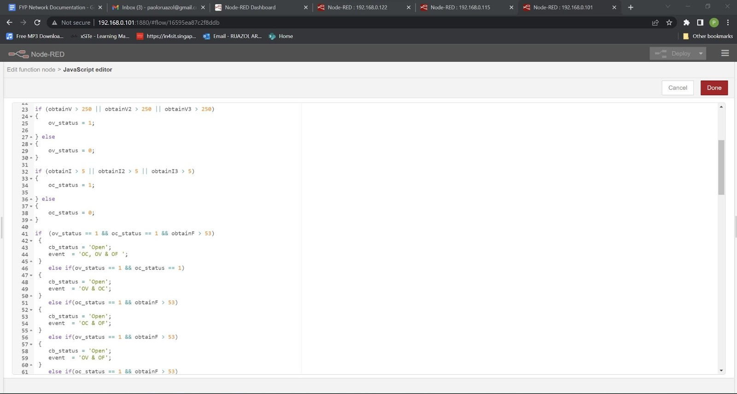
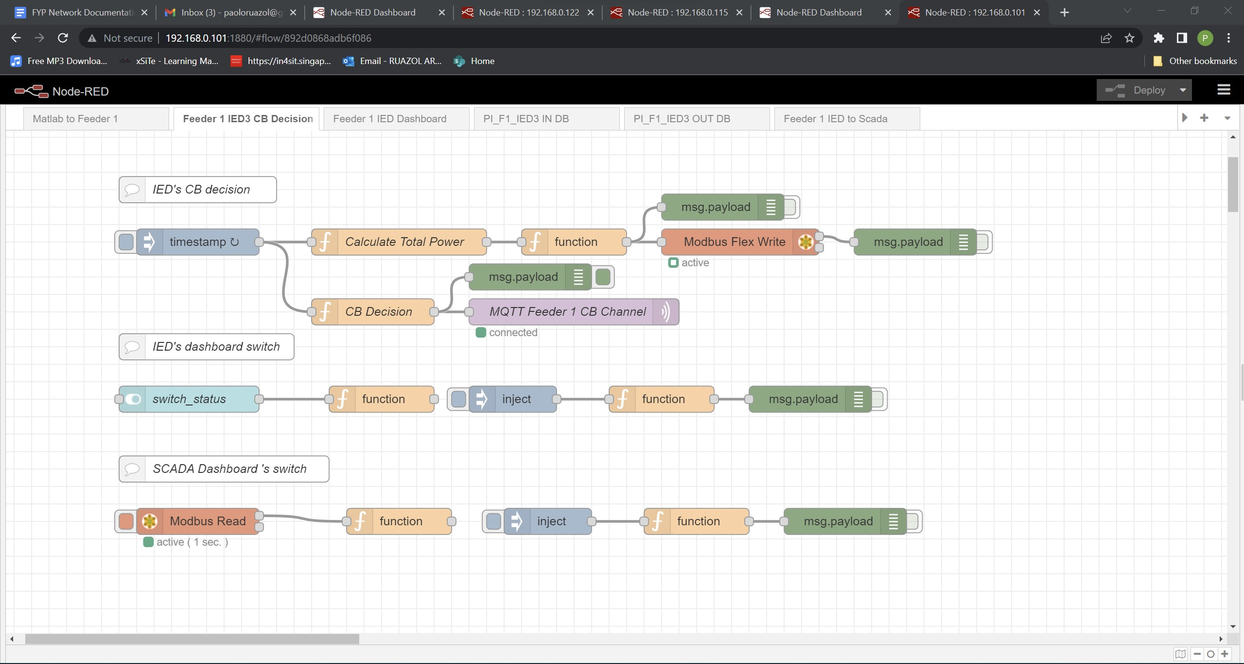
Configurations
Node Red configuration for IED to MATLAB circuit breaker decision
Condition 1- exceeding fault values
Condition 2- manually switching the CB via IED’s GUI,
Condition 3- manually switching the CB via SCADA’s GUI.
Node red code for CB tripping conditions

Slide 8
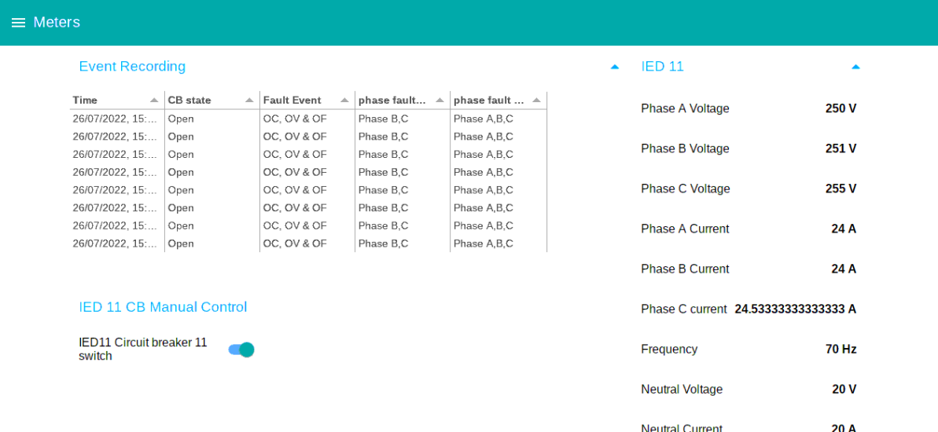
IED Raspberry Pi Dashboard
IED dashboard with event recording, manual CB control and input values.

Slide 9
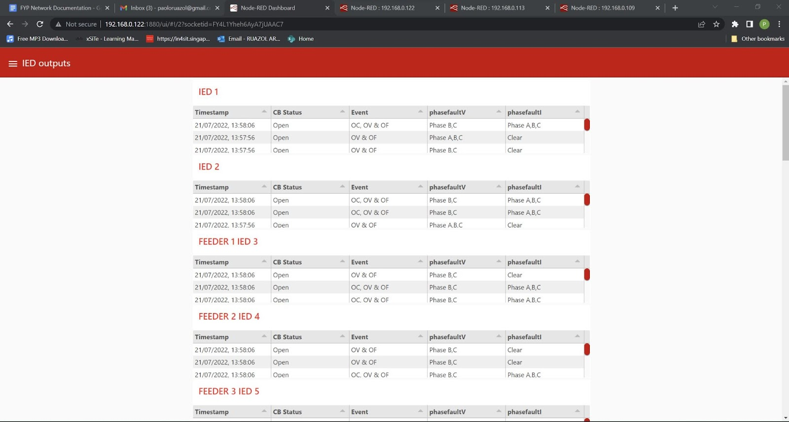
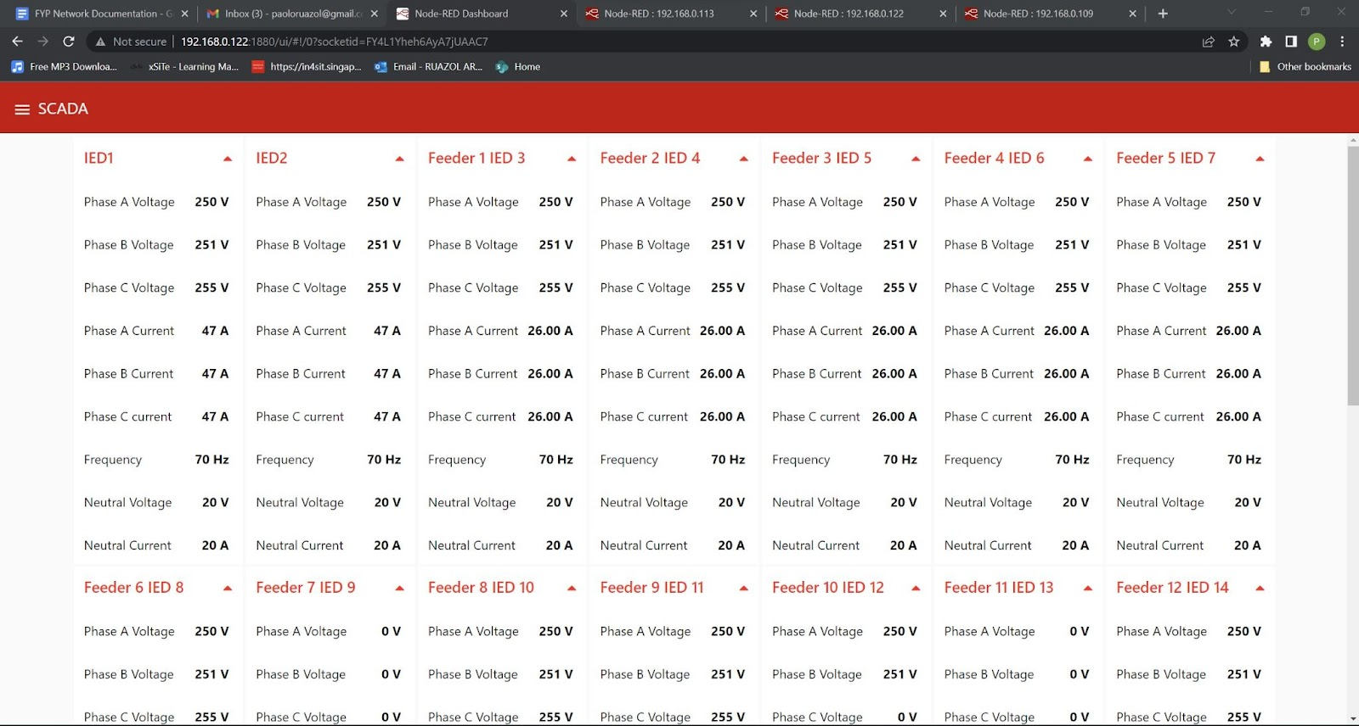
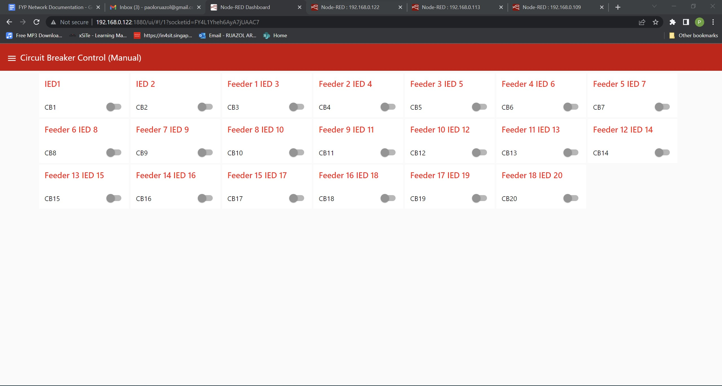
SCADA Raspberry Pi Dashboard
20 IEDs operational inputs compiled in Scada
20 IEDs fault records and CB status
Scada GUI to control circuit breaker

Slide 10
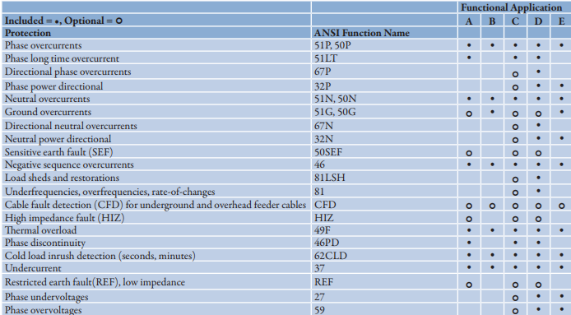
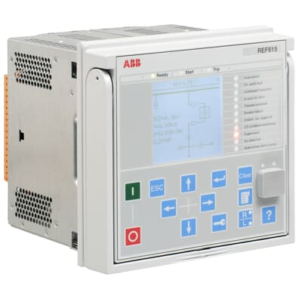
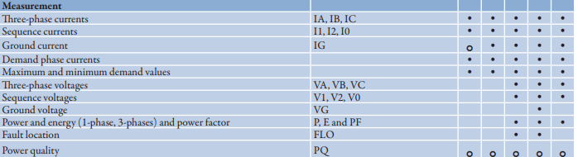
Future Works
REF 615 Feeder Protection functions [2]
REF 615 Feeder Protection and Control[2]
Adding more operational inputs values.
Adding more functionalities to the IED.
(Under voltage / Phase protection / Load Shedding)
REF 615 Feeder Protection operational input measurements [2]

Slide 11
References
[1] 12, V. mathuriya M., 30, A. khan O., 2, S. D., & 30, M. S. (2017, March 3). What is electrical grid? definition & types of an interconnection. Circuit Globe. Retrieved August 5, 2022, from https://circuitglobe.com/electrical-grid.html
[2] REF615 product guide ANSI Rev E - Na.eventscloud.com. (n.d.). Retrieved July 28, 2022, from https://na.eventscloud.com/file_uploads/23941d13d2219c637f4f3ea5b219dbe7_4_ABB_REF615ANSI_pg_1MAC105361-PG_ENe.pdf

